Slide 1

Your past. Your present. Your future.
Notes:
I would like you to try and remember your happiest memory. Now, think about yourselves 40 years from now. You may no longer remember that moment. Wouldn’t you like to capture those moments and relive them in the future? That’s what Capsulefy is about.

Slide 2
OVERVIEW
Idea
Team
MVP
Technologies
Viability study
Competitors
Pilot users
Planification
Costs
Profit estimations

Slide 3
IDEA

Slide 4





IDEA
Write
Schedule
Wait
Publish

Slide 5
TEAM

Slide 6
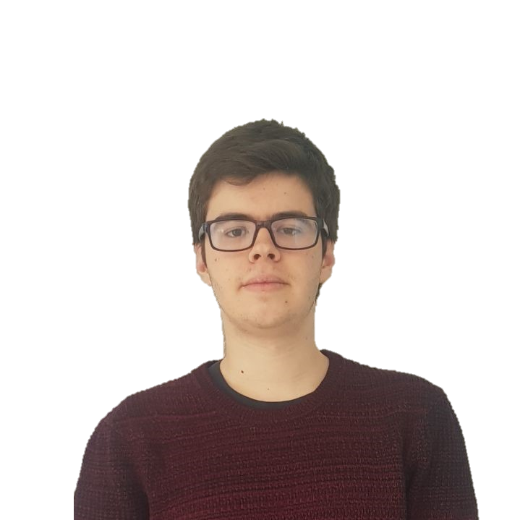



TEAM
Pablo Rebollo
Project manager, backend developer

Slide 7



TEAM
Adrián Cantón
Business manager, full-stack developer

Slide 8


TEAM
Daniel Carpio
Analist, frontend developer

Slide 9


TEAM
Juan Rodríguez
Requirements engineer, backend developer

Slide 10


TEAM
Rafael Fresno
Backend developer, API integration

Slide 11




GOALS

Slide 12





SUPPORTING TOOLS

Slide 13
MVP

Slide 14

CLASSIFICATION
=

Slide 15
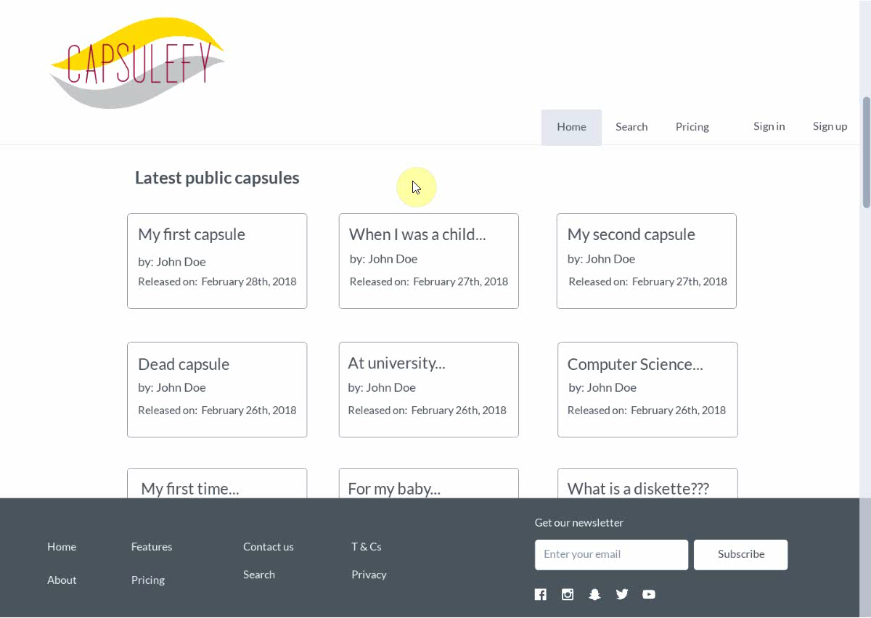
No logged user
Listing capsules

Slide 16
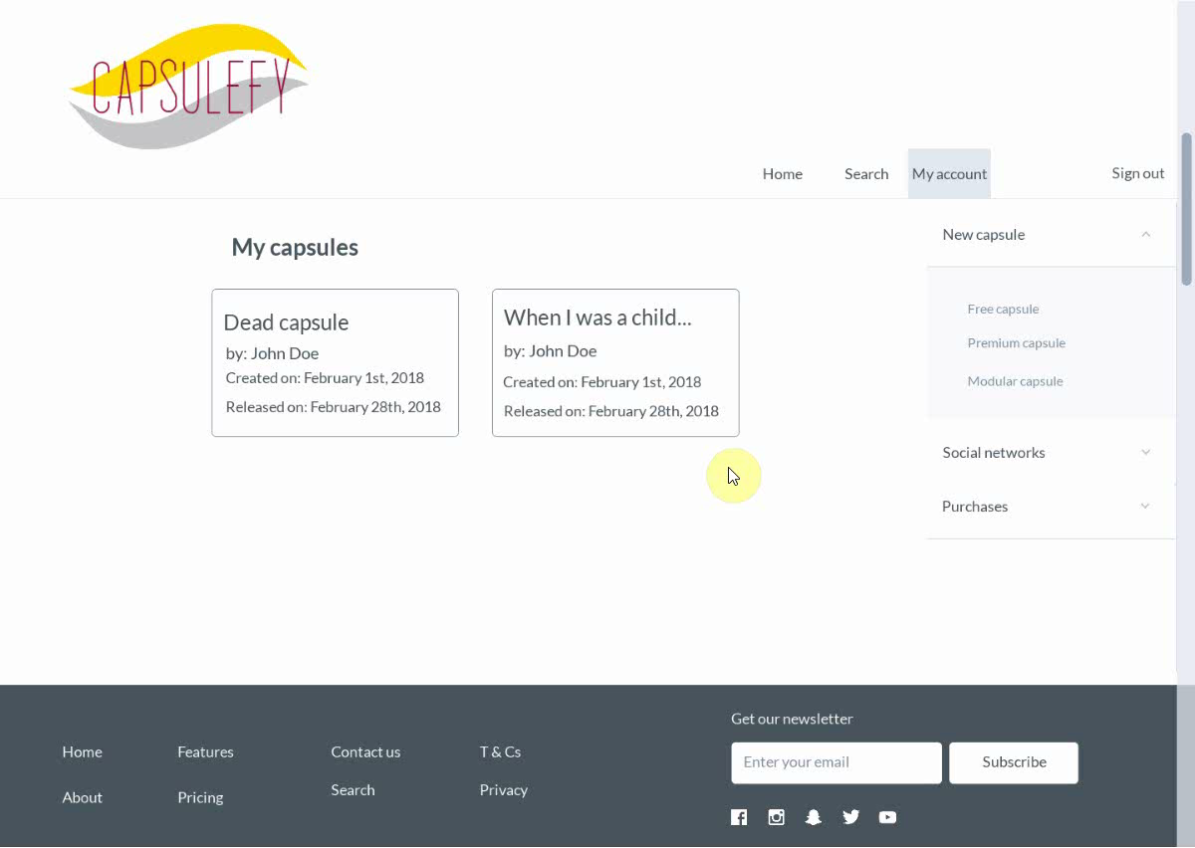
Logged-in user
Free capsules

Slide 17

Logged-in user
Premium capsules

Slide 18
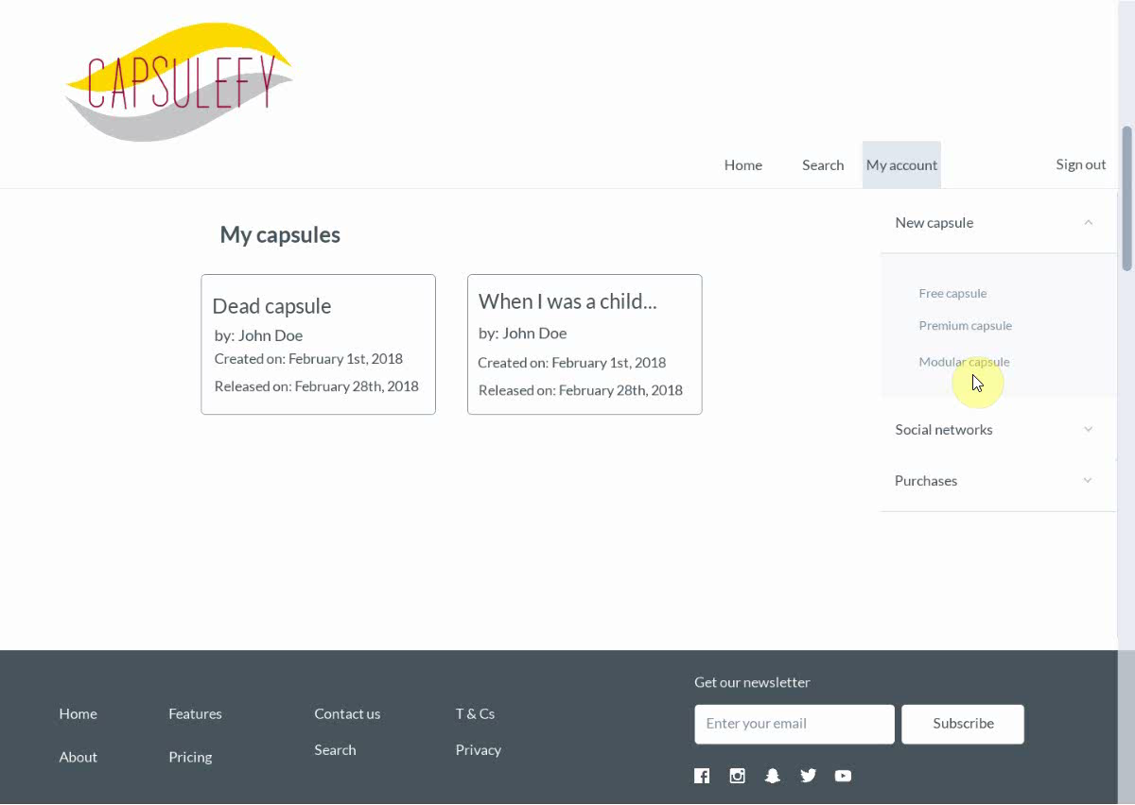
Logged-in user
Modular capsules

Slide 19
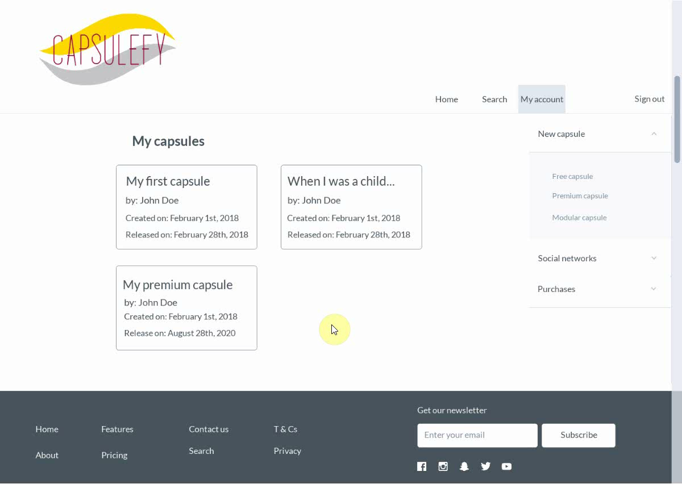
Logged-in user
Refresh capsules

Slide 20
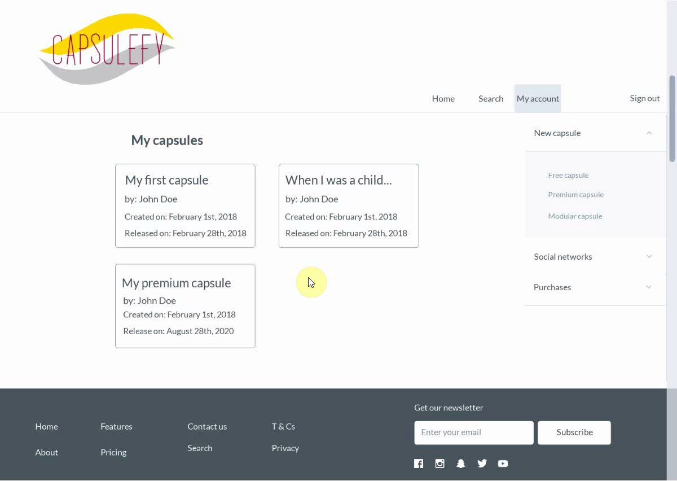
Logged-in user
Delete capsules

Slide 21
TECHNOLOGIES

Slide 22





TECHNOLOGIES
Main web app
Users and capsules APIs
Social media APIs

Slide 23



ALM
Notes:
Mention Toggl, although it is not part of the ALM itself.

Slide 24

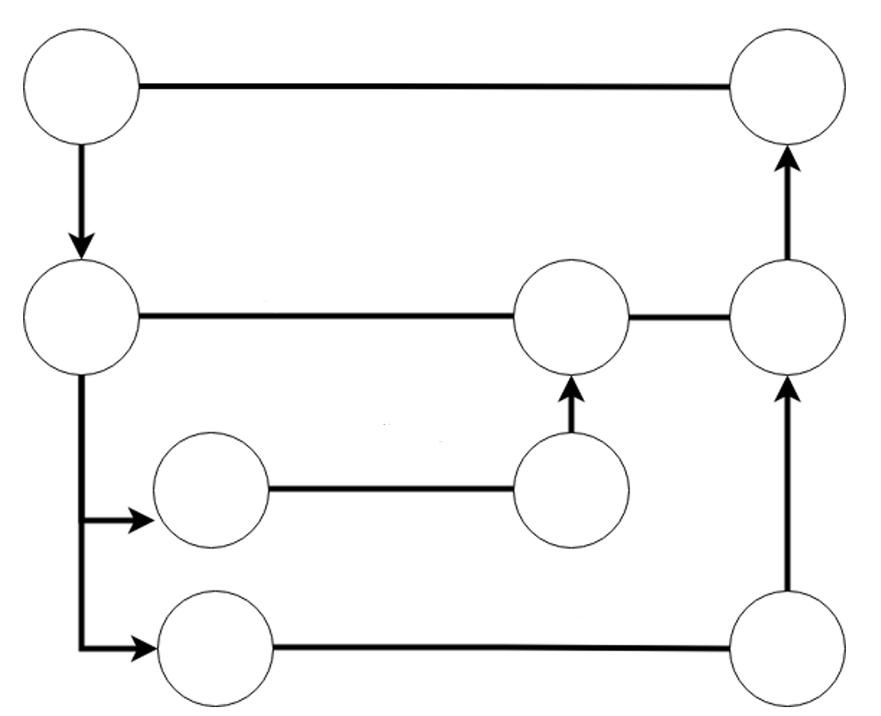
ALM
Master
Release X
Development
Features

Slide 25


HOSTING

Slide 26




TESTING
Functional
%
Integration
Performance
Coverage
Acceptance

Slide 27
VIABILITY STUDY

Slide 28
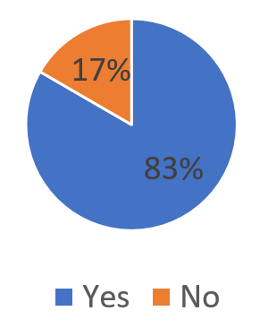
Do you know what a time capsule is?

Slide 29
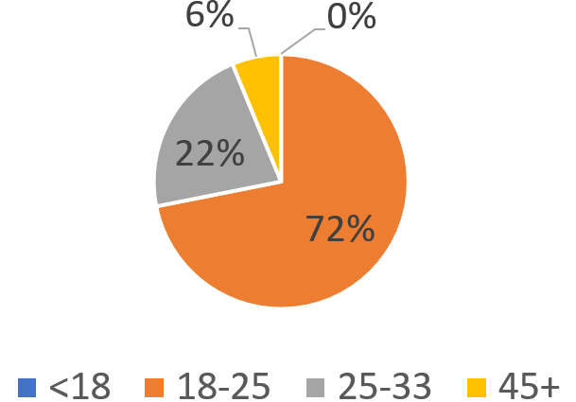
What is your age?

Slide 30
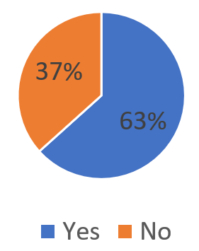
Are you interested in our idea?

Slide 31
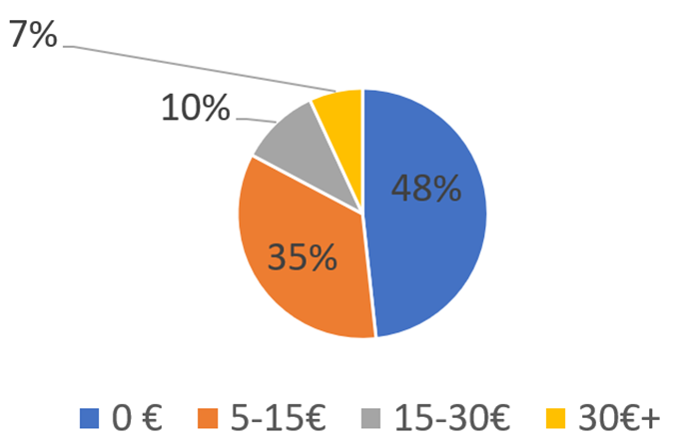
How much would you pay yearly?

Slide 32
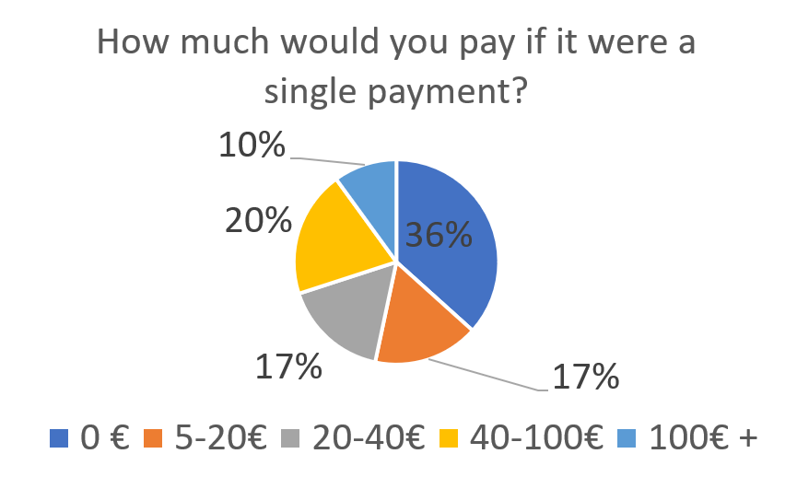
How much would you pay if it were a single payment?

Slide 33
COMPETITORS

Slide 34


COMPETITORS
 | Viajeros en el tiempo | Mytimecapsule | Miigen | thetimecapsule | Capsulefy
Automatic content publication
Free version
Premium version
Images
Videos
Social network interaction
Dead man switch

Slide 35



SWOT MATRIX
STRENGTHS | WEAKNESSES
OPPORTUNITIES | THREATS

Slide 36
PILOT USERS

Slide 37
PILOT USERS
Name | Age
Francisco R. | 55
Javier A. | 19
Valentin A. | 19
Antonio G. | 26
Name | Age
José Manuel J. | 21
Sandra C. | 28
José Manuel D. | 21

Slide 38


COMMITMENT

Slide 39
PAYMENT PLANS
 | Free | Premium/Modular
Price | 0 € | 11.99 €
Storage | 20 MB/user | 500 MB/capsule
Social network and email integration
Capsule scheduling | Up to 1 year | No limit
Capsule expiration | 6 months after release | No expiration
Private capsules (user-targeted)

Slide 40

PLANIFICATION
Each week
Sprint planning
Send deliverable
Each deliverable

Slide 41
PLANIFICATION
First sprint | Core use cases Piloting plan
Second sprint | Full MVP Feedback taken into account
Third sprint | Polished MVP

Slide 42
COSTS

Slide 43


COSTS
Realistic: 25218.33 – 26518.68 €
Optimistic: 24363.82 €
Pesimistic: 28501.39 €
Notes:
Factors taken into account: salaries, workplace, hosting, adversitement.

Slide 44
COSTS (REALISTIC 1)
Project duration | 4 months
Salaries | 20.80 €/hour
Hours per month | 40
Amortization (months) | 60
Equipment | 306.67 €
Hosting (1 year) | 669.34 €
Advertising (6 months) | 300 €
Risk prevention | 3% (734.51 €)
Total | 25218.33 €

Slide 45
COSTS (REALISTIC 2)
Project duration | 4 months
Salaries | 20.80 €/hour
Hours per month | 40
Amortization (months) | 60
Equipment | 306.67 €
Hosting (1 year) | 669.34 €
Advertising (6 months) | 600 €
Risk prevention | 7% (1734.87 €)
Total | 26518.68 €

Slide 46
COSTS (OPTIMISTIC)
Project duration | 4 months
Salaries | 20.80 €/hour
Hours per month | 40
Amortization (months) | 60
Equipment | 306.67 €
Hosting (1 year) | 669.34 €
Advertising (6 months) | 180 €
Risk prevention | 0% (0 €)
Total | 24363.82 €

Slide 47
COSTS (PESIMISTIC)
Project duration | 4 months
Salaries | 20.80 €/hour
Hours per month | 40
Amortization (months) | 60
Equipment | 306.67 €
Hosting (1 year) | 669.34 €
Advertising (6 months) | 600 €
Risk prevention | 15% (3717.57 €)
Total | 28501.39 €

Slide 48




RISKS
Notes:
Computers not working, contracts changing, servers down, incompatible schedules, negative reception and losses.

Slide 49
PROFIT ESTIMATION

Slide 50
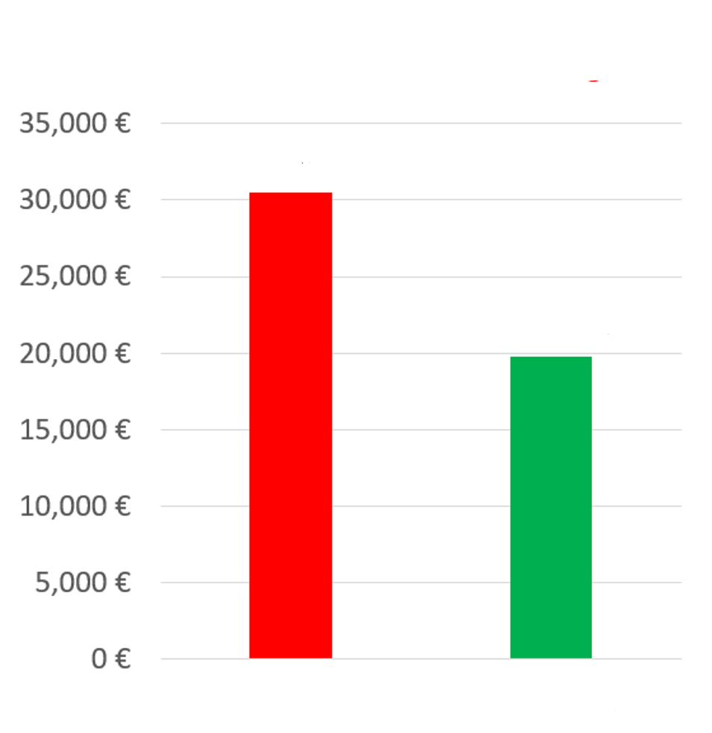
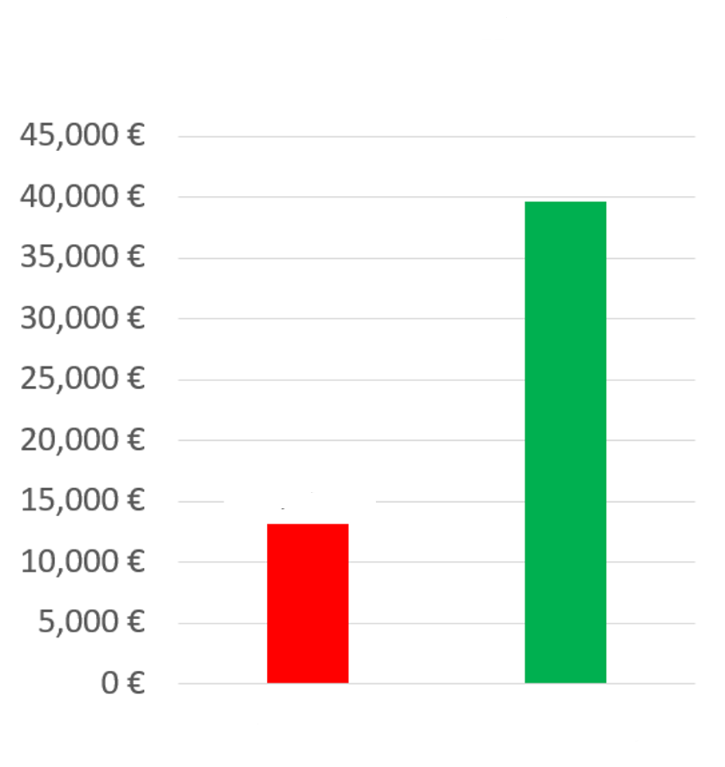
PROFIT ESTIMATION
Year 1: 2000 sales
Balance: -10714 €
Year 1: 2000 sales
Balance: 15726 €
30514 €
39600 €
19800 €
13159 €
Losses
Earnings
Losses
Earnings

Slide 51
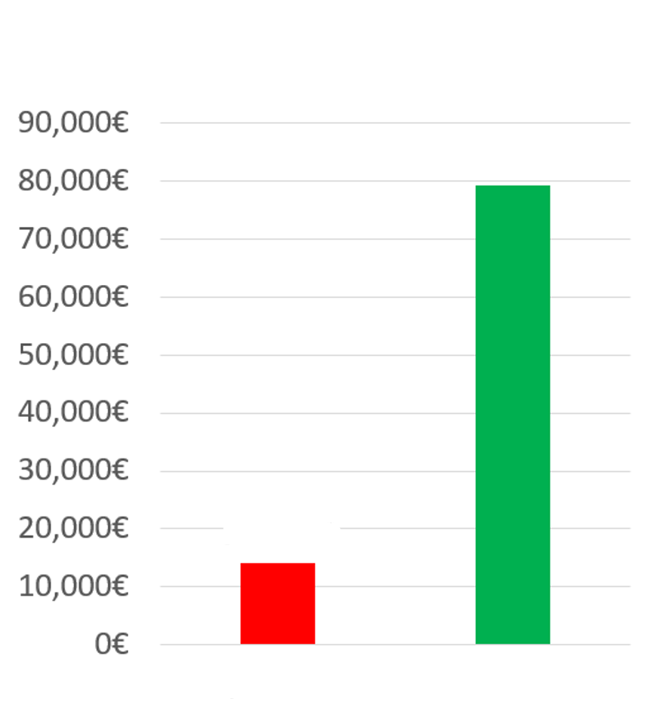
PROFIT ESTIMATION
Year 2: 8000 sales
Balance: 80903 €
79200 €
14023 €
Losses
Earnings

Slide 52
THANKS!
Notes:
Insurance companies: offer capsules to their clients, with no expiration and special prices. Create endpoint for insurances to send their client data.

Slide 53

https://capsulefy.herokuapp.com
capsulefy.communications@gmail.com
https://marvelapp.com/4395g15/screen/53795517

Slide 54

CORE USE CASES
Refresh deadman switch
Select type of capsule
<<includes>>
Unregistered user
Registered user
Pay for a
capsule

Slide 55
CORE USE CASES
Delete
capsule
Create free
capsule
Unregistered user
View
capsule
Registered user

Slide 56
FIRST SPRINT
- Prepare development environment
- Implement data models
- Work on requirements
- Test the system
- Take actions according to feedback

